Slide 1
BERT: Pre-training of Deep Bidirectional Transformers for Language Understanding
Faculty Of Computers And Artificial Intelligence
6 July 2021

Slide 2
Outline
Introduction
Problem statement
Datasets
Preprocessing
Background
Proposed Model
Implementation
Results
Conclusion
Future Works

Slide 3
Introduction
Natural language processing
NLP committees and their interest in the Arabic language
Why do we need Sentiment Analysis?
Understand linguistics and modeling of speech and text.
Analyze different forms of text.
Mining of human behavioral writings e.g. mining of customer opinions and feedback

Slide 4
Problem Statement
Classifying polarity of a tweet text containing an emoji within a fitting context is a problem in sentiment analysis.
Identifying the sentiment of a tweet and assigning one of three labels (Positive, Negative, Neutral).

Slide 5
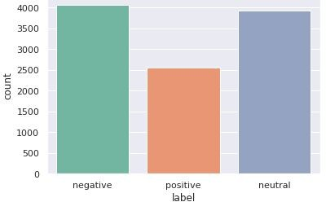
Datasets (1)
The new Arabic sarcasm detection dataset that was used
The dataset contains 10.457 tweets, 1.682(16 %) of which are sarcastics
The tweets are mostly in Egyptian dialect and they were annotated using Amazon’s Mechanical Turk

Slide 6
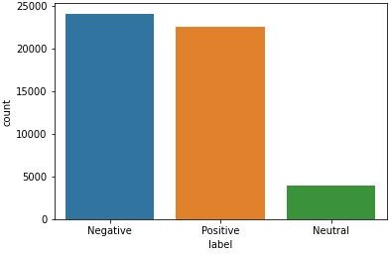
Datasets (2)
The 40000 Egyptian tweets.
More data does not always help, but it can and as for our problem. Did it work?.
After using both of datasets, we can see how many the tweets contain in the fig.
Imbalanced Dataset ?

Slide 7
Preprocessing (1)
Cleaning Phase
Replace # with word “جﺎﺗﺷﺎھ”
Replace urls with word “طﺑار”
Replace @ mentions with word “مدﺧﺗﺳﻣ”
Removing the digits and non-Arabic letters
Removing elongation
Keeping the stopwords for contextual meaning
Removing redundant punctuations
Removing special characters
Keeping Emojis effect with a 5.6 percentage

Slide 8
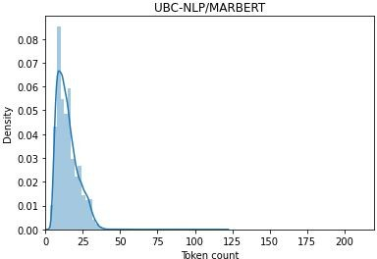
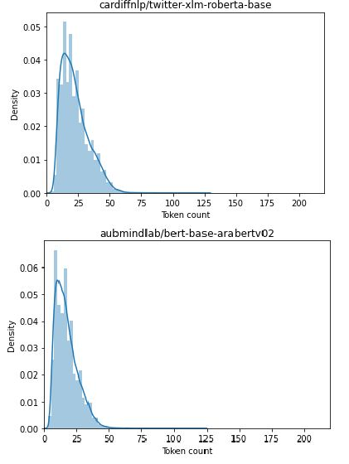
Preprocessing (2)
Tokenization in Bert
●
The library contains tokenizers for all the
models
Most of the tokenizers are available in two
flavors: a full python implementation and a
“Fast” implementation
We see in the next fig the max length of all
the model

Slide 9
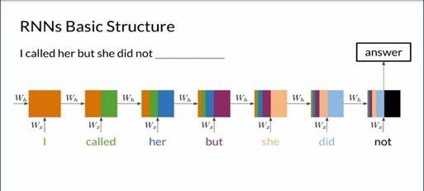
Background: state of the art approaches in sequence modeling (1)
Recurrent Neural Network (RNN):
Internal memory
○
Feedforward networks
○
Vanishing Gradient

Slide 10
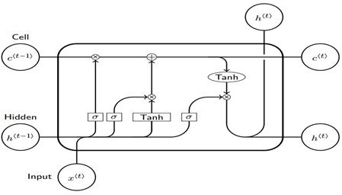
Background: state of the art approaches in sequence modeling (2)
Long Short-Term Memory (LSTM):
Capable of learning long-term dependencies
Cell State
Hidden State
Forget Gate
Input Gate
Output Gate
Slow to Train
Words are passed in sequentially and generated sequentially

Slide 11
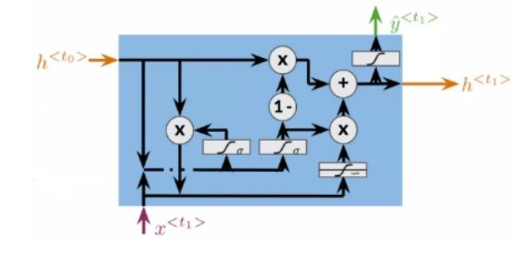
Background: state of the art approaches in sequence modeling (3)
Gated Recurrent Unit (GRU):
Solve the vanishing gradient problem
Update Gate
Reset Gate
Slow convergence
Low learning efficiency

Slide 12
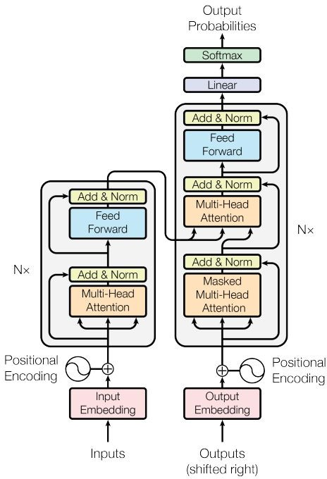
Proposed Models: Transformers (1)
Neural Machine Translation.
No concept of time step for the input.
We pass all the words of the sentence simultaneously and determine the word embedding simultaneously...
less time to train.
The context of words are better learned.
1
2

Slide 13
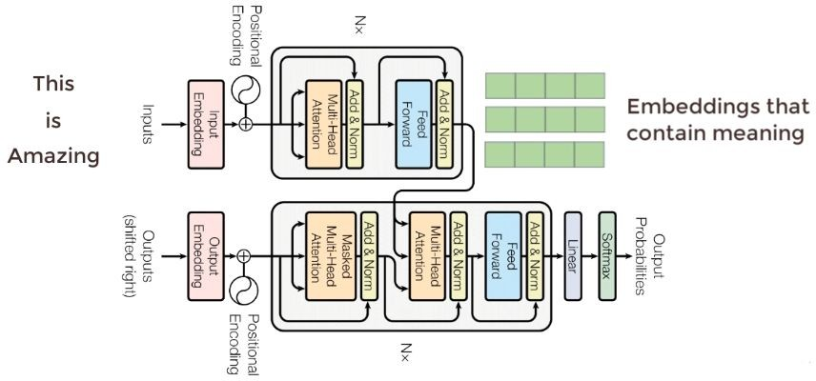
Proposed Models: Transformers (2)
Translate from English to German
Encoder
What is english?
What is context?
Decoder
How to map from English to German?

Slide 14
Proposed Models: Attention mechanism (1)
An approach to solve the problem of loss of relevant information in long sentences is to use the attention mechanism.
The first word of the source sentence is probably highly correlated with the first word of the target sentence.
Each time the model predicts an output word, it only uses parts of an input where the most relevant information is concentrated instead of an entire sentence.

Slide 15
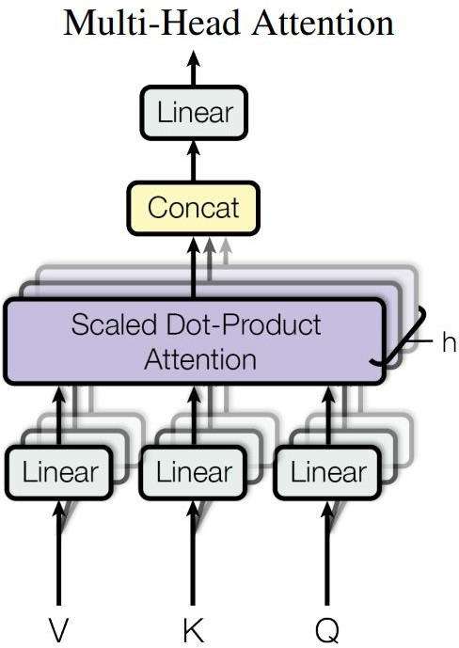
Proposed Models: Attention mechanism (2)
Multi-head attention allows the model to jointly attend to information from different representation subspaces at different positions.

Slide 16
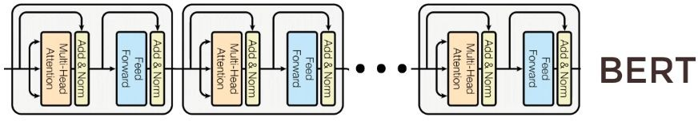
Proposed Models: BERT (1)
Bidirectional Encoder Representation from Transformers
Stack of encoders.
Understanding of Language
Pre-train BERT to understand language
Fine tune BERT to learn specific task

Slide 17
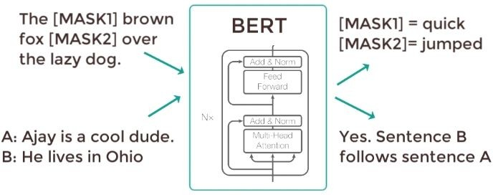
Proposed Models: BERT (2)
Pre-train BERT to understand language (Two Phases)
Masked Language Model
Help BERT to understand context.
Next Sentence Prediction
Helps BERT to understand
context across different sentences.

Slide 18
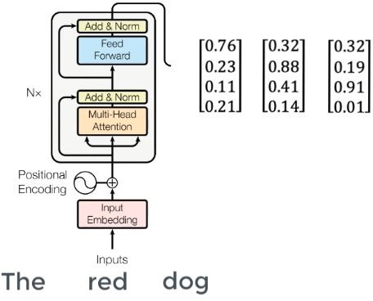
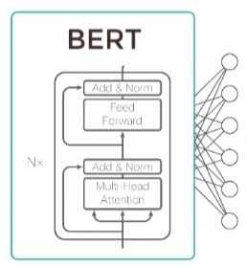
Proposed Models: BERT (3)
Fine tune BERT to learn specific NLP task
Generate the Embedding Vectors which encapsulate the meaning of the context
Add linear classifier to determine the the classification of the sentence (positive, Negative, Neutral)
Linear classifier Layer

Slide 19
Proposed Models:
The proposed models for sentiment analysis:
MARBERT
XLM-roberta-base
ARABERTv02
Imbalanced dataset solution:
Cross Entropy
Focal loss

Slide 20
Proposed Models: Cross Entropy
Cross Entropy Loss asks the model to be very confident about the ground truth prediction.
measures the performance of a classification model whose output is a probability value between 0 and 1.
Cross-entropy loss increases as the predicted probability diverges from the actual label.
So predicting a probability of .012 when the actual observation label is 1 would be bad and result in a high loss value

Slide 21
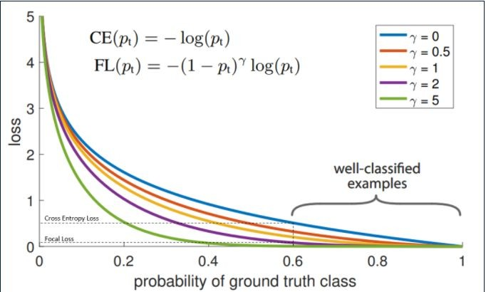
Proposed Models: Focal Loss
Solution of the imbalanced data.
FL makes it easier for the model to predict without being 80-100% sure.
Giving the model a bit more risk when making predictions.
FL will penalize majority samples during loss calculation and give more weight to minority class sample will penalize majority samples during loss calculation and give more weight to minority class sample.

Slide 22
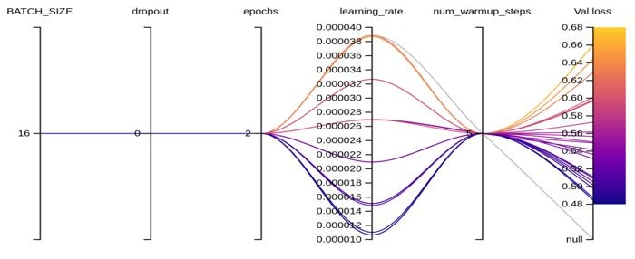
Proposed Models: Sweep
Automatically finding the best possible combination of hyperparameter values
Number of epochs.
Batch size.
Number of layers.
number of nodes in each layer.

Slide 23
Proposed Models: MarBERT
Randomly sample 1B Arabic tweets from a large in-house dataset of about 6B tweets.
Support Emoji.
12 self attention heads.
768 hidden dimensions.
a vocabulary of 100K WordPieces.

Slide 24
Proposed Models: XLM
pre-training on a large corpus of Twitter in multiple languages (8 different language including Arabic)
Xlm was trained on TweetEval (~198M multilingual tweets)
TweetEval, the benchmark associated with the Findings of EMNLP 2020 paper "TweetEval: Unified Benchmark and Comparative Evaluation for Tweet Classification".
Supports Emojis.

Slide 25
Proposed Models: AraBERT
AraBERT was trained on several datasets
OSCAR unshuffled and filtered.
Arabic Wikipedia dump from 2020/09/01.
The 1.5B words Arabic Corpus.
The OSIAN Corpus.
Assafir news articles. Huge thank you for Assafir for giving us the data.
Doesn’t Support Emoji

Slide 26
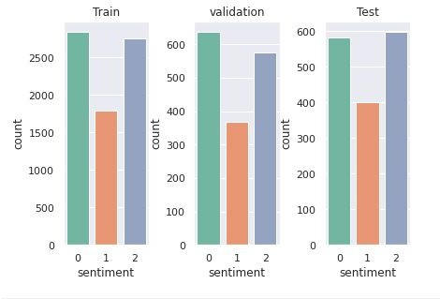

Implementation
For the three models we take 3% of the data for the validation and test.
As for softmax Applies the Softmax function to an n-dimensional input Tensor rescaling them so that
the elements of the n-dimensional output Tensor lie in the range [0,1] and sum to 1.
Softmax is defined as:
When the input Tensor is a sparse tensor then the unspecifed values are treated as -inf.
pyarabic,Transformers,BertTokenizerFast,AutoToke nizer,BertModel.

Slide 27
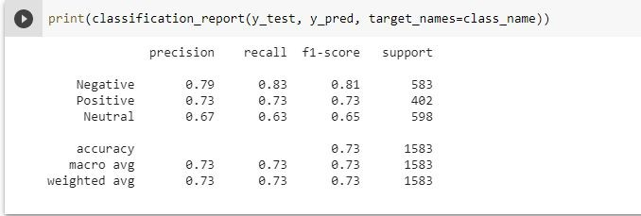
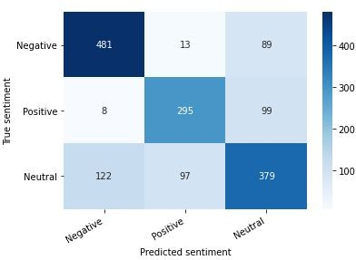
Results
Model 1:
Best result came out from both the datasets was Marbert.
The highest accuracy in ArSarcasm was 0.71 in Sarcasm And Sentiment Detection In Arabic competition as shown in next slide.

Slide 28
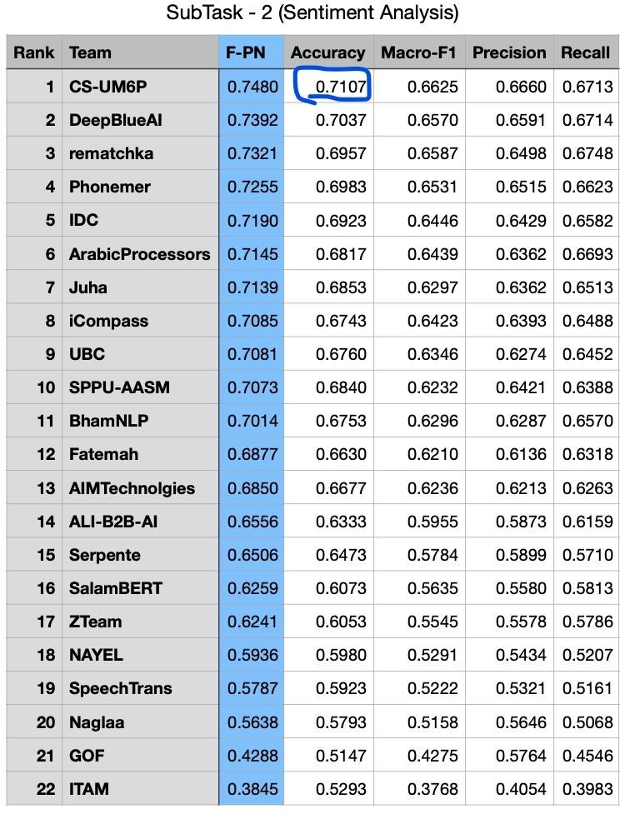
Results
Sarcasm And Sentiment DetectionInArabic competition
As we can see team CS-UM6P was the highest one for sentiment analysis task.

Slide 29
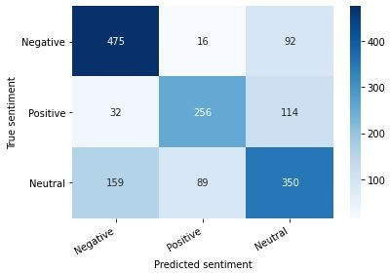
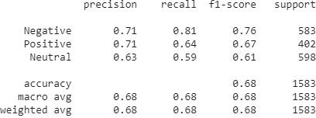
Results
Model 2 : xlm-roberta-base

Slide 30
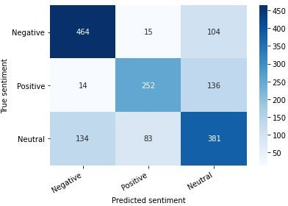
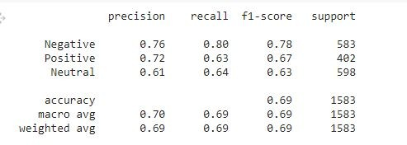
Results
Model 3 : AraBert

Slide 31
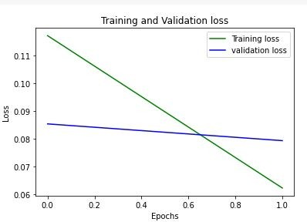
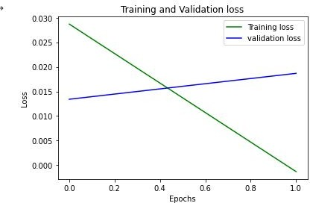
Results
Best ArSacrasm vs All (the two datasets)
Marbert_ArSacrasm
Marbert_All

Slide 32
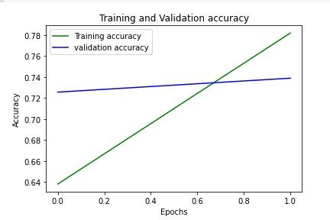
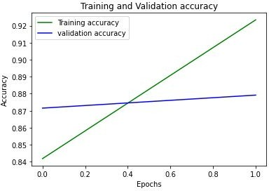
Results
Marbert_ArSacrasm
Marbert_All

Slide 33
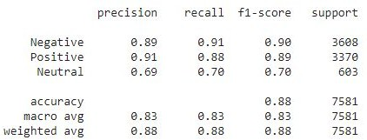
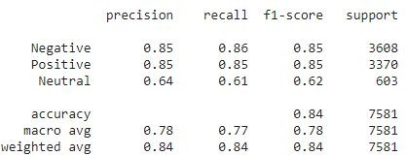
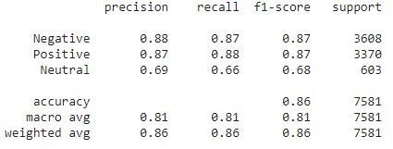
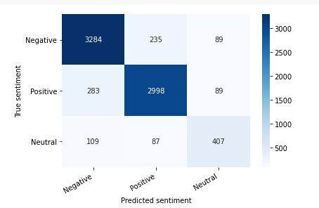
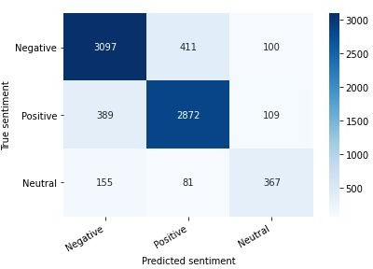
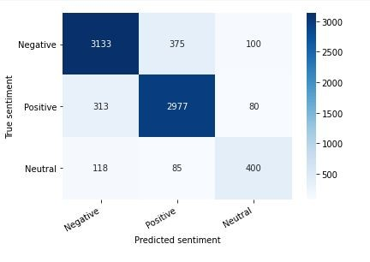
Results
As for all models for the improved data (or all data)
Marbert Xlm-roberta-base
Arabert

Slide 34
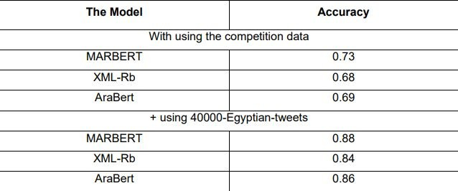
Conclusion
After running the pre-processing methods we found that results about the three models

Slide 35
Future Work
We may use the model in applications like social media monitoring, customer support management, and analyzing customer feedback.
Increase the number of encoders, decoders, and Number of attention heads
.
According to the confusion matrix results, we can increase the diversity of training examples in the Dataset to improve the accuracy.

